Slide 1
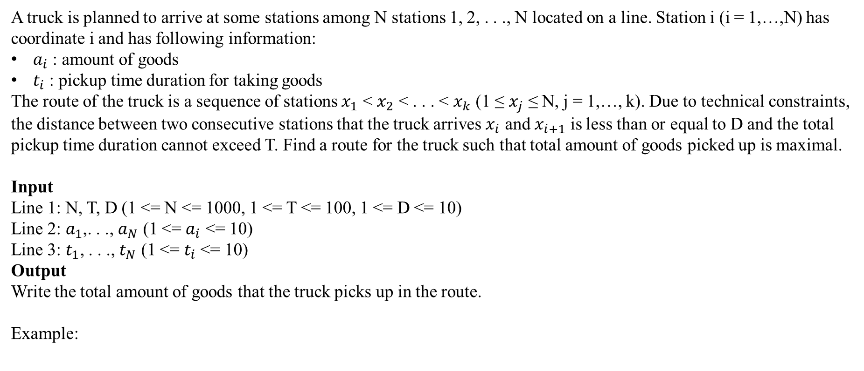
A truck is planned to arrive at some stations among N stations 1, 2, . . ., N located on a line. Station i (i = 1,…,N) has coordinate i and has following information:
$a_{i}$ : amount of goods
$t_{i}$ : pickup time duration for taking goods
The route of the truck is a sequence of stations $x_{1}$ < $x_{2}$ < . . . < $x_{k}$ (1 ≤ $x_{j}$ ≤ N, j = 1,…, k). Due to technical constraints, the distance between two consecutive stations that the truck arrives $x_{i}$ and $x_{i+1}$ is less than or equal to D and the total pickup time duration cannot exceed T. Find a route for the truck such that total amount of goods picked up is maximal.
Input
Line 1: N, T, D (1 <= N <= 1000, 1 <= T <= 100, 1 <= D <= 10)
Line 2: $a_{1}$,. . ., $a_{N}$ (1 <= $a_{i}$ <= 10)
Line 3: $t_{1}$, . . ., $t_{N}$ (1 <= $t_{i}$ <= 10)
Output
Write the total amount of goods that the truck picks up in the route.
Example:
Input | Output
6 6 2 6 8 5 10 11 6 1 2 2 3 3 2 | 24

